Slide 1
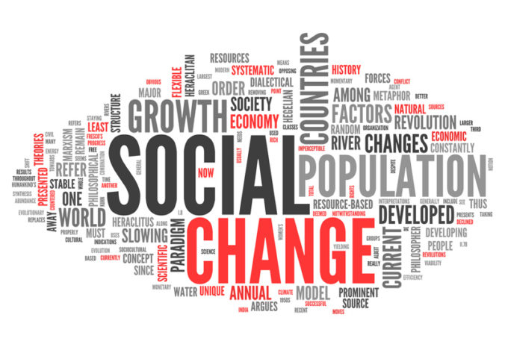

Career Development Centre
SRMIST – kattankulathur

Slide 2
Learning Objectives
1. To define “Social Change”
2. To enhance the concepts of human well-being and to understand Social Change and Social Problems.
3. To give the Idea of social functioning, and theoretical perspectives of Social Change.
4. To become familiar with the Social Change in Society.
Career Development Centre
SRMIST – kattankulathur

Slide 3
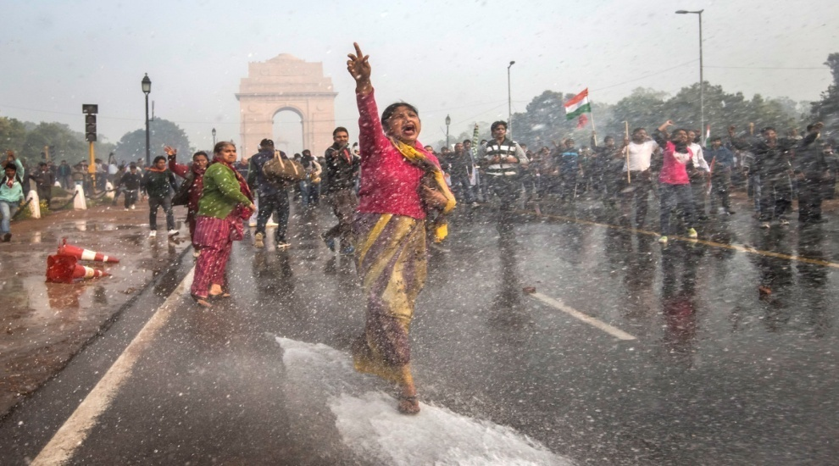
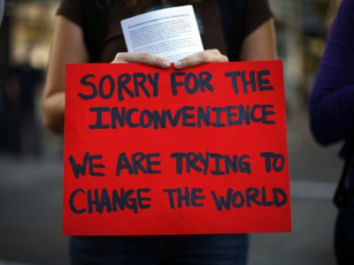
Introduction to Social Change
Social change in society may be as a result of the expediency needed in providing solutions to specific social problems faced in a society.
Change is an integral part of our lives and our existence has been through stages of growth and development.
Career Development Centre
SRMIST – kattankulathur

Slide 4
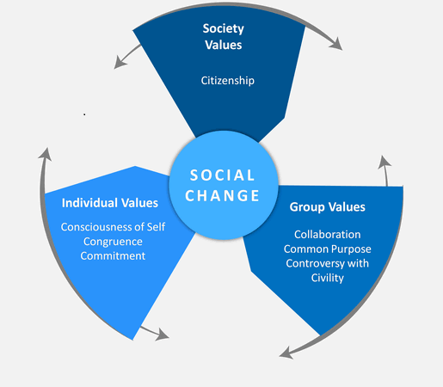
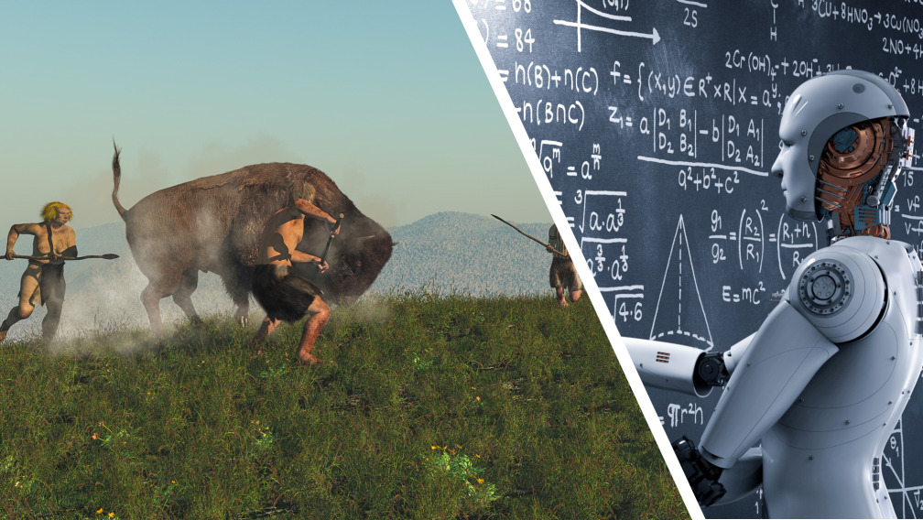
Understanding Social Change
Social change refers to modifications or replacements in social structure.
Social change is a natural part of the process of human growth and evolution. (Human Progress ,Stone tools to Artificial Intelligence)
Career Development Centre
SRMIST – kattankulathur

Slide 5
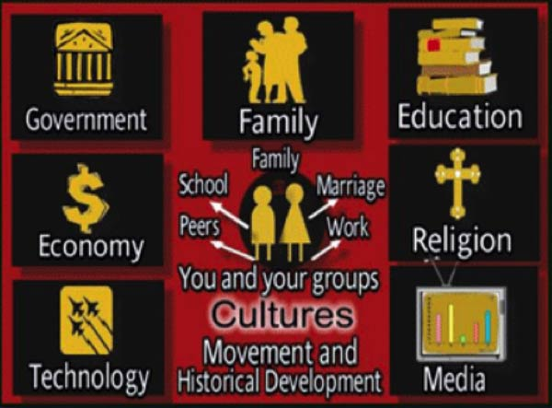
Understanding Social Change
It also talks about the existence of relationship among the people. (Rules and positions are important not individual)
Cultural symbol, social order, beliefs /values and practices are part of social change.
Career Development Centre
SRMIST – kattankulathur

Slide 6
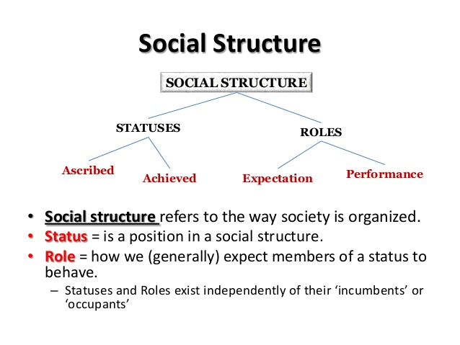
Career Development Centre
SRMIST – kattankulathur

Slide 7

The 100th Monkey Theory
Career Development Centre
SRMIST – kattankulathur

Slide 8
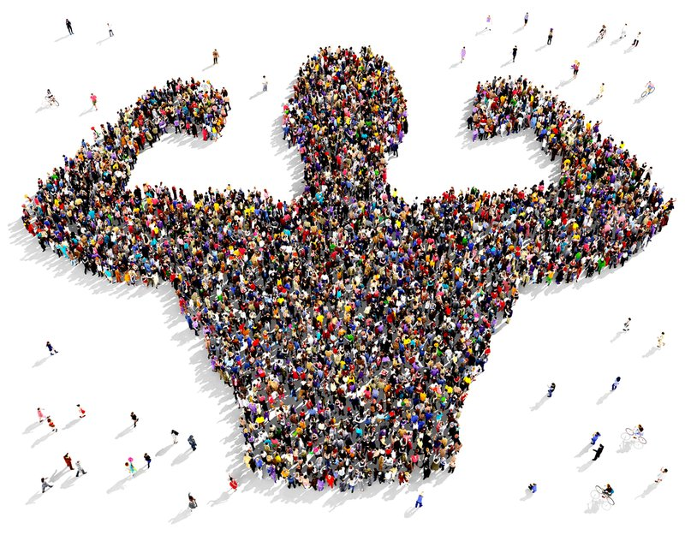
Characteristics of Social Change
Career Development Centre
SRMIST – kattankulathur

Slide 9
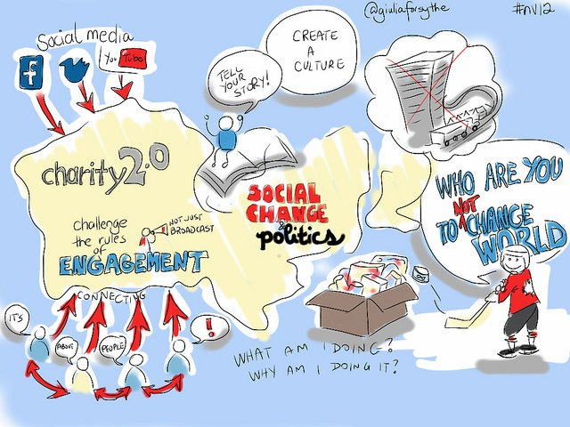
There are EIGHT essential Characteristics of Social Change
1. Universality of Social Change
2. Social Change is not Uniform
3. Social Change involves Community Change
4. Nature and Speed of Social Change in Various Societies is Different
Career Development Centre
SRMIST – kattankulathur

Slide 10


5. Social Change is again Relative to Time
6. Social Change shows a Chain-Reaction Sequence
7. Several Interdependent and Interacting Factors of Social Change
8. No one can Predict Social Change
Career Development Centre
SRMIST – kattankulathur

Slide 11
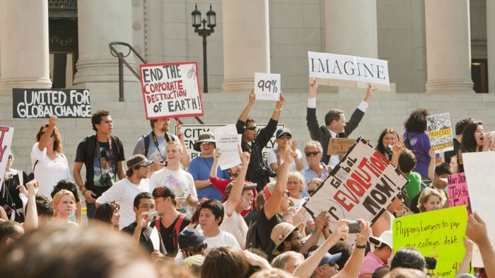
Types of Social Change
Career Development Centre
SRMIST – kattankulathur
Career Development Centre
SRMIST – kattankulathur

Slide 12

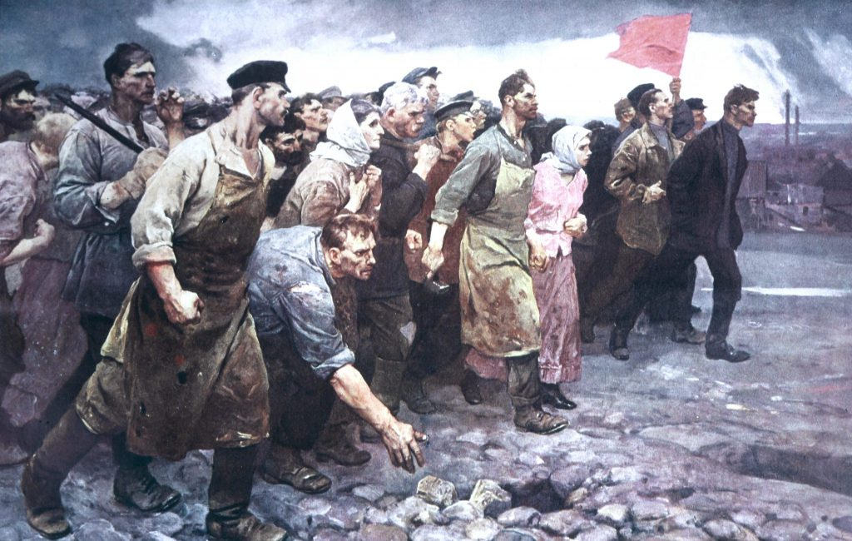
Types of Social Change
Alternative social change
Redemptive social change
Reformative social change
Revolutionary social change
Career Development Centre
SRMIST – kattankulathur

Slide 13
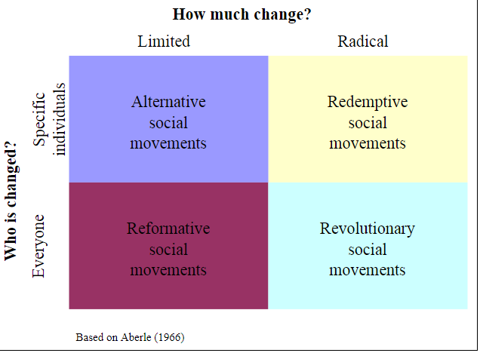
A social change is typically based upon two factors - first, whom the movement is trying to change, and second, how much change a movement is advocating
Career Development Centre
SRMIST – kattankulathur

Slide 14
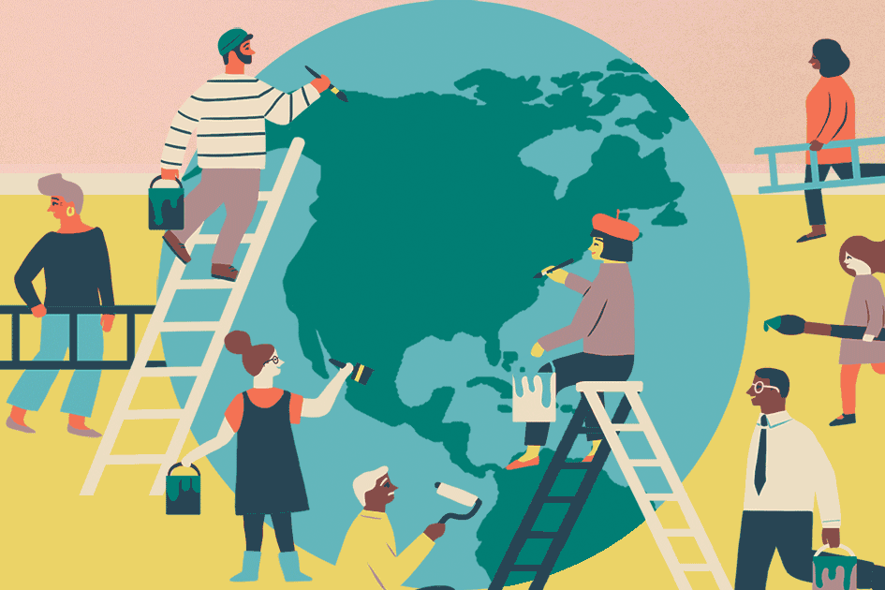
Causes of Social Change
Career Development Centre
SRMIST – kattankulathur

Slide 15
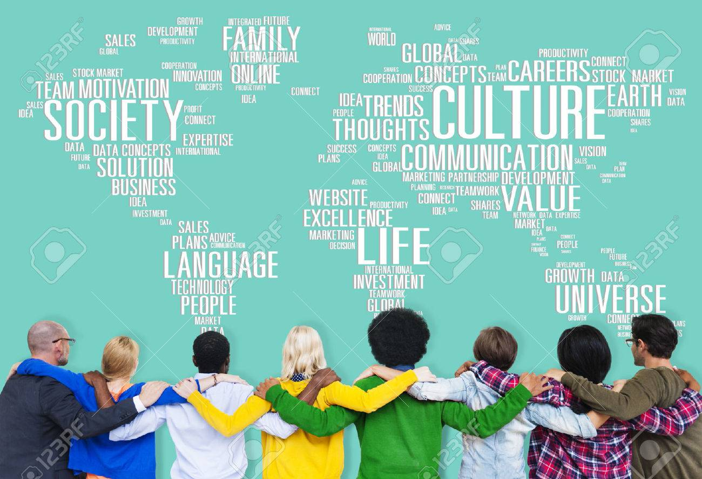

Causes of Social Change
There are few identifiable characters of social change. Some of them are as follows:
A large part of change in society is caused by change in culture.
New ideas and modification of old ideas in a new context bring wide scale changes in society.
Demographic change is caused by an increase in birth and decline in death and migration of populations.
Social change is also caused by tension and conflict
To bring about deliberate change in the values, norms, institutions, culture relationships and traditions of the society.
Career Development Centre
SRMIST – kattankulathur

Slide 16

Thank you…
Career Development Centre
SRMIST – kattankulathur

